Slide 1
NAVIGATING THE ORAL HEALTH WORKFORCE CRISIS
WITH PAUL LOGAN, POLLY RAIBLE, CARLOS SMITH and AMY TALOMA

Slide 2
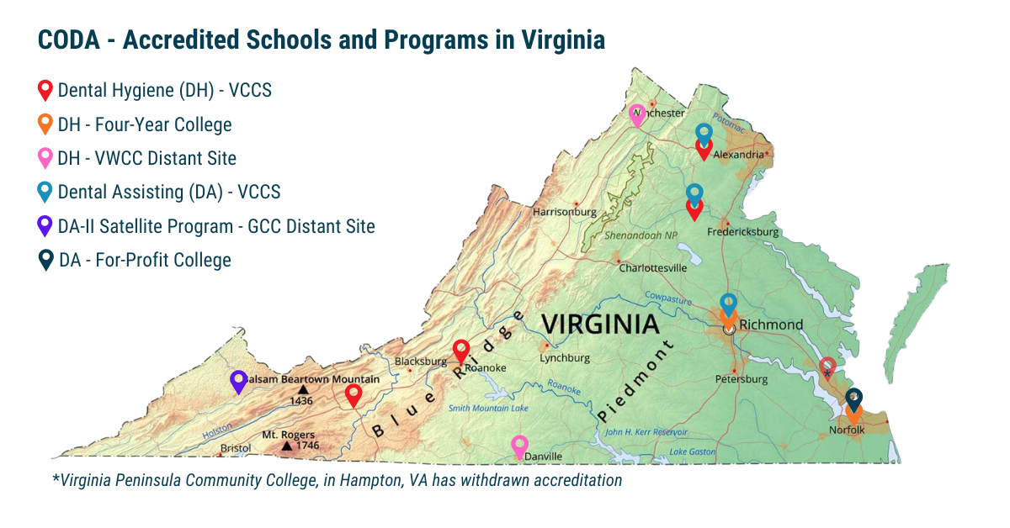

Slide 3
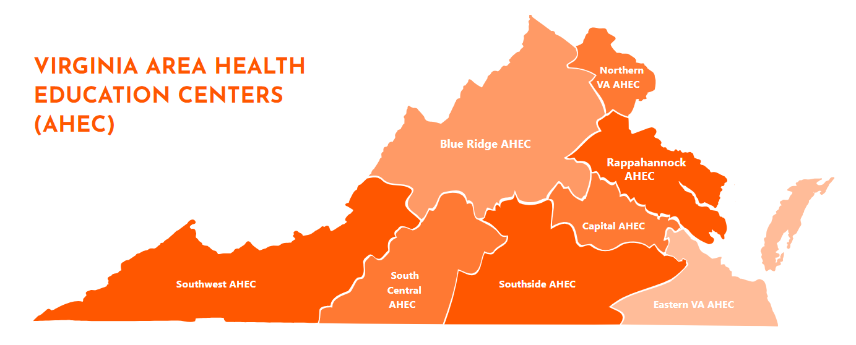

Slide 4
NAVIGATING THE ORAL HEALTH WORKFORCE CRISIS
WITH PAUL LOGAN, POLLY RAIBLE, CARLOS SMITH and AMY TALOMA

